Slide 1
IP II PART 3
Connecting to Databases
1
1

Slide 2

Contents
Connect to an existing Database
Retrieve Data from a Database
Modify Existing Data
Remove Existing Data

Slide 3
PHP MySQL Database
With PHP, you can connect to and manipulate databases.
MySQL is the most popular database system used with PHP.
What is MySQL?
MySQL is a database system used on the web
MySQL is a database system that runs on a server
MySQL is ideal for both small and large applications
MySQL is very fast, reliable, and easy to use
MySQL is free to download and use
MySQL | uses standard | SQL
MySQL | compiles on a | number | of | platforms

Slide 4
Cont..
The data in a MySQL database
in tables. A
are stored
table is a collection of
related data, and it consists of columns and rows.
Databases are information
useful for storing
categorically.
A company may have a database with the following tables:
Employees
Products
Customers
Orders

Slide 5
PHP Create a MySQL Database
A database consists of one or more tables.
You will need special CREATE privileges to create or
to delete a MySQL database.
Create a MySQL Database Using MySQLi
The CREATE DATABASE statement is used to create a
database in MySQL.

Slide 6
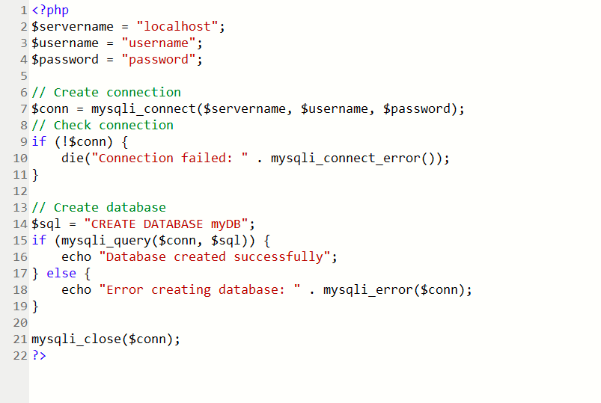
The following examples create a database named "myDB":

Slide 7
Create a MySQL Table Using MySQLi
The CREATE TABLE statement is used to create a table in MySQL.
We will create a table named "MyGuests", with five columns: "id", "firstname", "lastname", "email" and "reg_date":
CREATE TABLE MyGuests (
id INT(6) UNSIGNED AUTO_INCREMENT PRIMARY KEY,
firstname VARCHAR(30) NOT NULL, lastname VARCHAR(30) NOT NULL, email VARCHAR(50),
reg_date TIMESTAMP DEFAULT CURRENT_TIMESTAMP ON UPDATE CURRENT_TIMESTAMP)

Slide 8
Cont..
After the data type, you can specify other optional
attributes for each column:
NOT NULL - Each row must contain a value for that column, null values are not allowed
DEFAULT value - Set a default value that is added when no other value is passed
UNSIGNED - Used for number types, limits the stored
data to positive numbers and zero
AUTO INCREMENT - MySQL automatically increases the value of the field by 1 each time a new record is added

Slide 9
Cont..
PRIMARY KEY - Used to uniquely identify the rows in a table. The column with
AUTO_INCREMENT
Each table should have a primary key column (in this case: the "id" column). Its value must be unique for each record in the table.
PRIMARY | KEY | setting | is often an | ID
number, | and | is often | used with

Slide 10
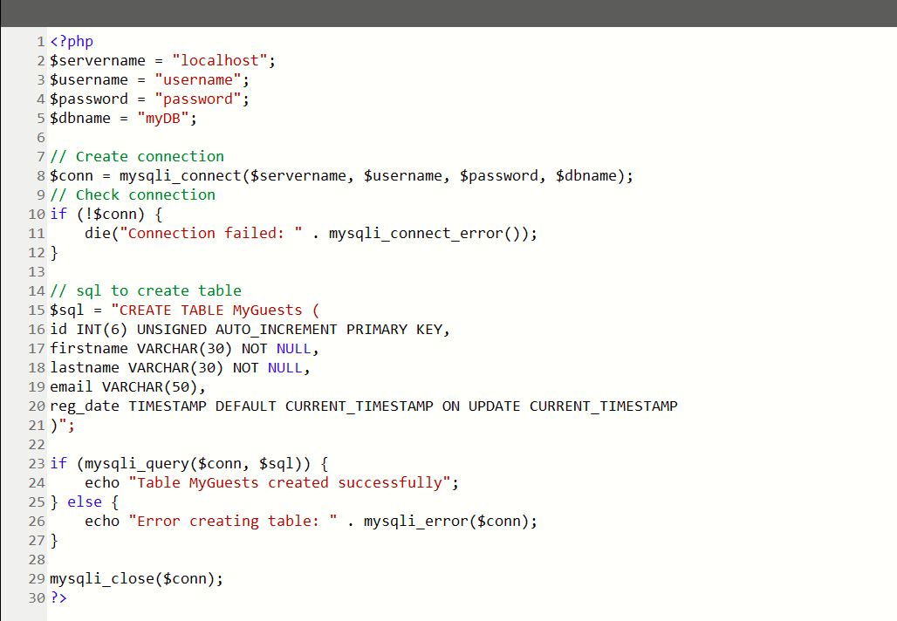
Example

Slide 11
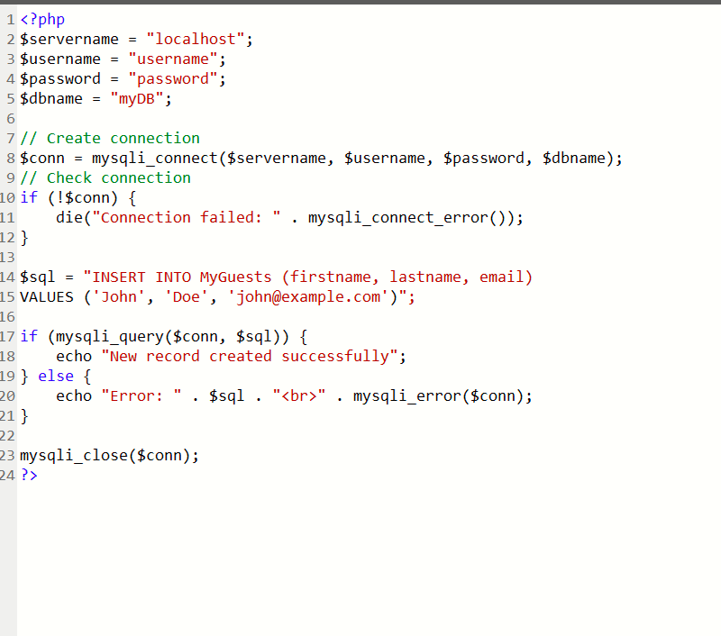
insert.php

Slide 12
Insert Data Into MySQL Using MySQLi
▪ | Here are some syntax rules to follow:
▪ | The SQL query must be quoted in PHP
▪ | String values inside the SQL query must be quoted
▪ | Numeric values must not be quoted
▪ | The word NULL must not be quoted
▪ | The INSERT INTO statement is used to add new records | to a | MySQL
table:
INSERT INTO table_name (column1, column2, column3,...)
VALUES (value1, value2, value3,...)
Note: If a column is AUTO_INCREMENT (like the "id" column)
with default update of current_timesamp (like the "reg_date" ^{or}
TIMESTAMP
column), it is no need to be specified in the SQL query; MySQL will automatically add the value.

Slide 13
Insert Data into a Database from an HTML Form
Multiple SQL statements must be executed with the
mysqli_multi_query() function.
The following examples add three new records to the "MyGuests" table:

Slide 14
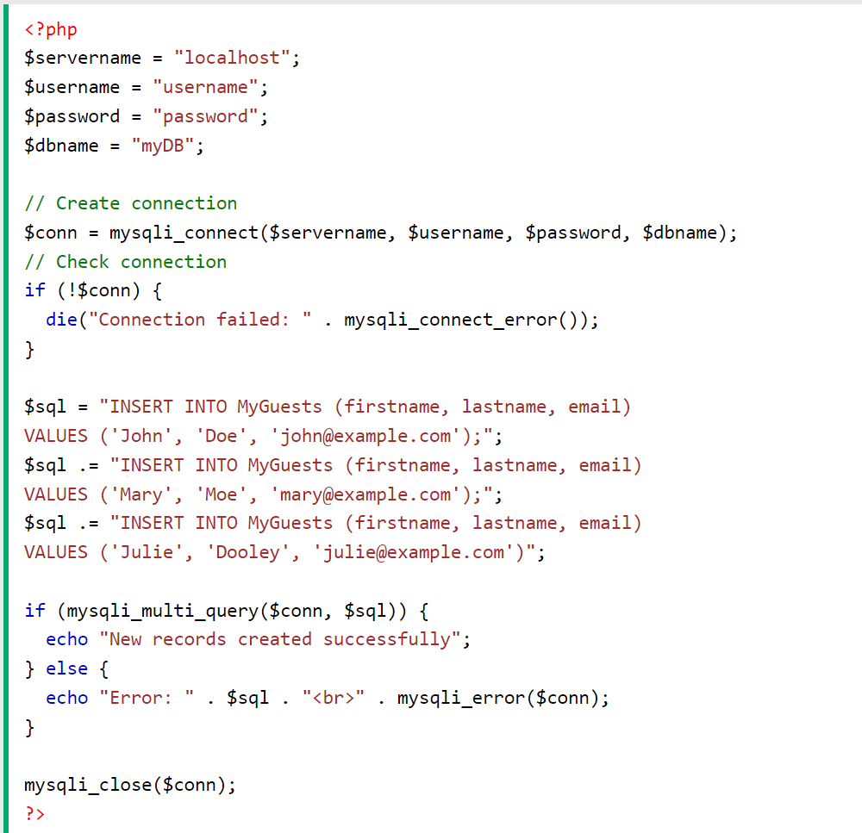

Slide 15
Cont. …
When a
user clicks the submit button in the HTML form in
the example above, the form data is sent to "insert.php".
The
"insert.php" file connects to a database, and
retrieves the values from the form with the PHP $_POST
variables.
Then, the mysqli_query() function executes the INSERT INTO statement, and a new record will be added to the “student" table.

Slide 16
PHP MySQL Select
The SELECT statement is used to select data from a database.
Select/search Data From a Database Table
The SELECT statement is used to select data from a database.
Syntax
SELECT column_name(s)
FROM table_name

Slide 17
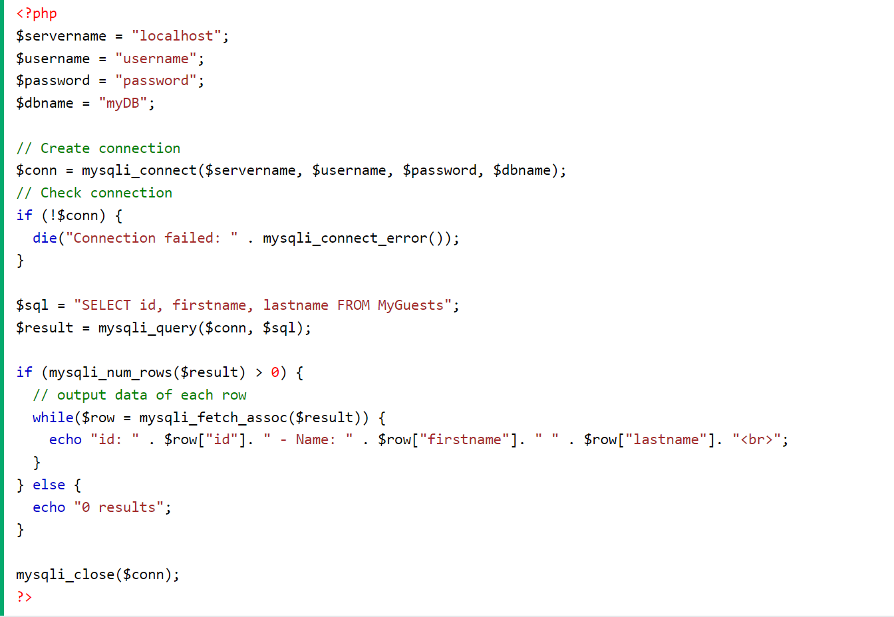
Example
2/22/2020

Slide 18
PHP MySQL Use The WHERE Clause
Select and Filter Data From a MySQL Database
The WHERE clause is used to filter records.
The WHERE clause is used to extract only those records that fulfill a specified condition.
SELECT column_name(s) FROM table_name WHERE column_name operator value
The following example selects the id, firstname and lastname columns from the MyGuests table where the lastname is "Doe", and displays it on the page:

Slide 19
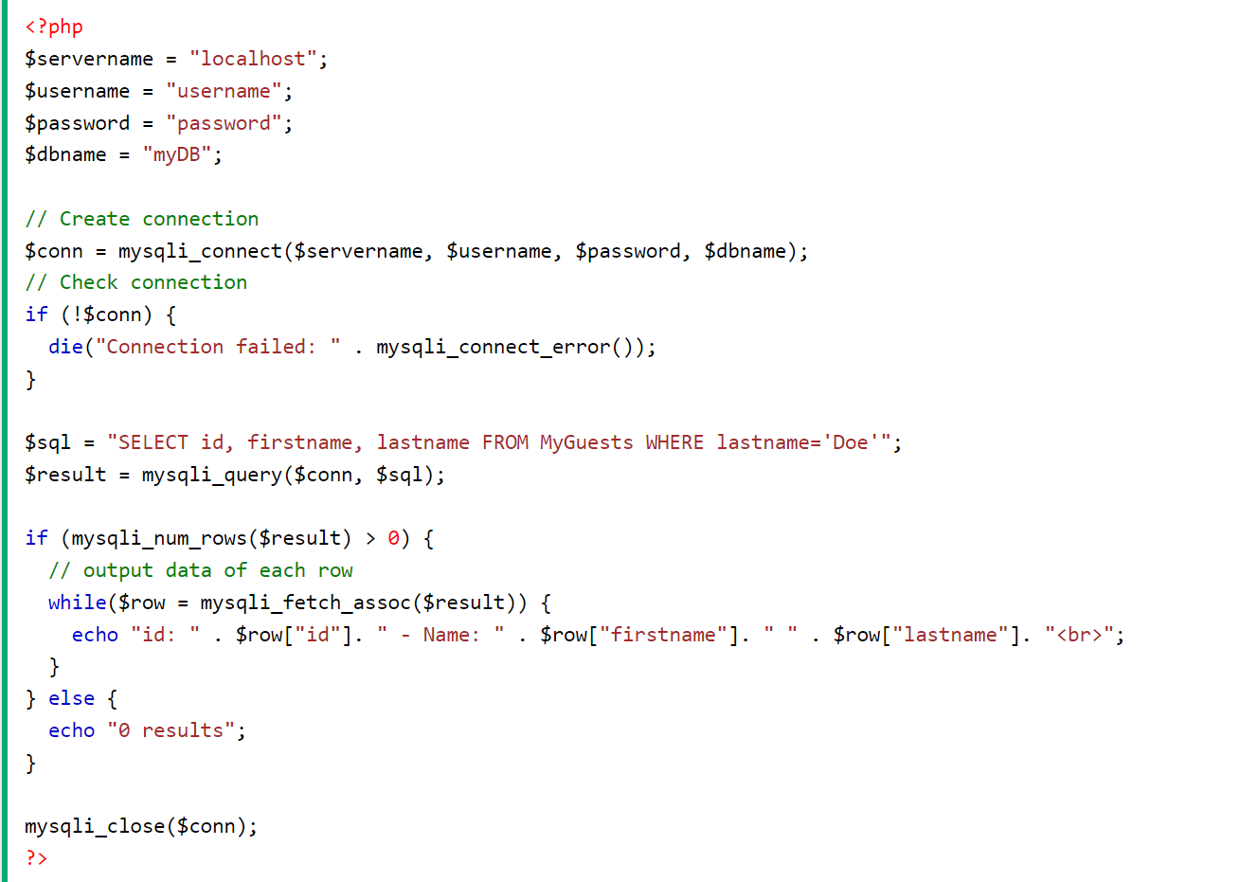
Example

Slide 20
PHP MySQL UPDATE Query
The UPDATE statement table. | is used to update | the records in a MySQL database
Updating Database Table | Data
The UPDATE statement in a database table. | is used to change | or modify the existing records
It is typically used in conjugation with the WHERE clause to apply the
changes to only those records that matches specific criteria.
The basic syntax of the UPDATE statement can be given with:
UPDATE table_name SET column1=value, column2=value2,... WHERE column_name
= some_value
Let's make a SQL query using the UPDATE statement and WHERE clause, after that we will execute this SQL query through passing it to the mysqli_query() function to update the tables records.

Slide 21
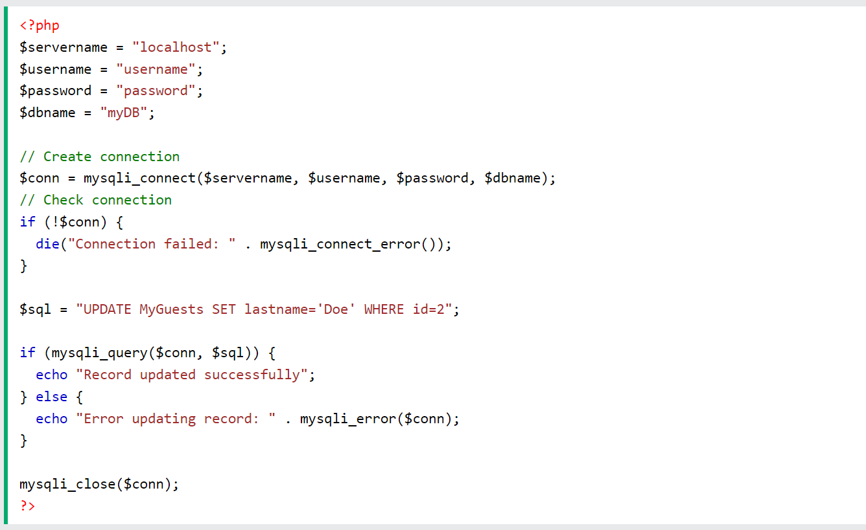
Example:

Slide 22
PHP MySQL Delete Data
Delete Data From a MySQL Table Using MySQLi
The DELETE statement is used to delete records from a
table:
DELETE FROM table_name
WHERE some_column = some_value
Notice the WHERE clause in the DELETE syntax:
The WHERE clause specifies which record or records that should be deleted.
If you omit the WHERE clause, all records will be deleted!

Slide 23
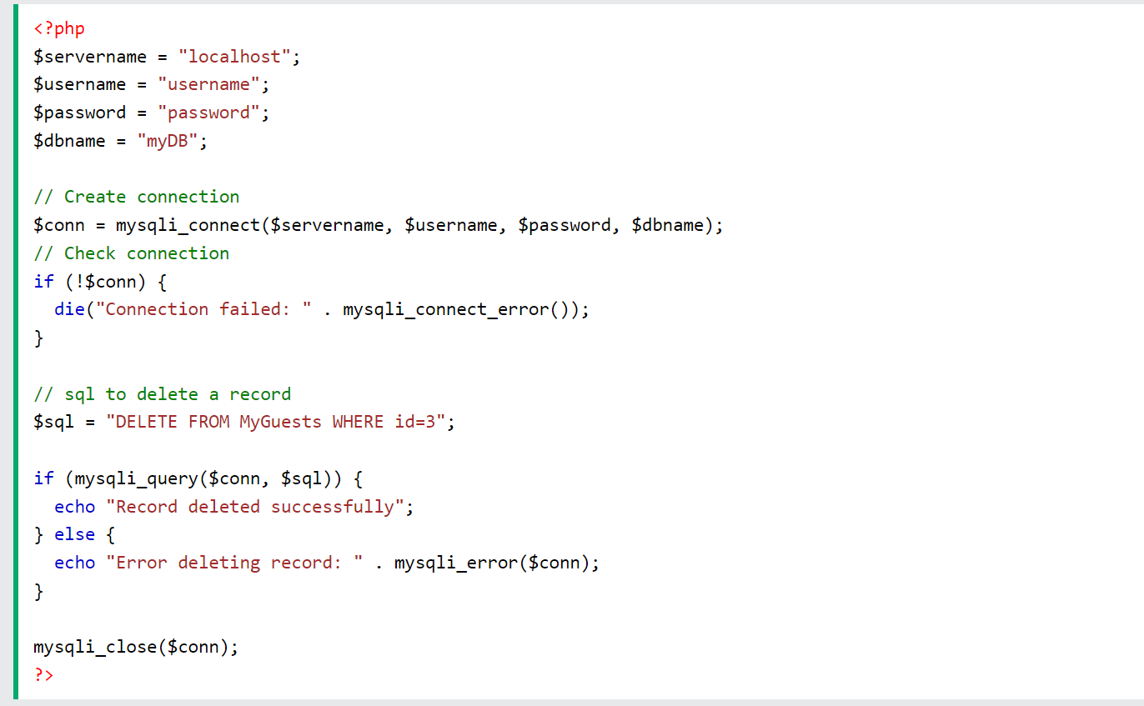
Example:

Slide 24
Login Form/index.php
<div id= "form">
<h1>Login Form</h1>
<form name="form" action= "login.php" method="post">
<label>Username:</label>
<input type="text" id= "user" name="user"></br></br>
<label>Password:</label>
<input type="password" id= "pass" name= "pass"></br></br>
<input type="submit" id= "btn" value="Login" name=
"submit"></br></br>

Slide 25
Login Form/login.php
<?php
require 'connection.php';
if(isset($_POST['submit'])){
$username= $_POST['user'];
$password= $_POST['pass'];
$sql= "select * from login2 where username = '$username' and password= '$password'";
$result= mysqli_query($conn, $sql);
$row= mysqli_fetch_array($result, MYSQLI_ASSOC);
$count=mysqli_num_rows($result);
if($count==1){
header("location:welcome.php");
}
else{
echo '<script>
window.location.href = "index3.php";
alert("login failed");
</script>';
}
}
?>

Slide 26
Thank you!

